Slide 1

Ferranti Effect
Under the supervision of :
Dr. Hisham Al-Harbi
Turki Al-Thobaiti 44400944
Omar Al-Ghamdi 44206994
Turki Al-Zahrani 44451275
Hashim Al-Thumail 44452465

Slide 2


What Is Ferranti Effect
The Ferranti Effect is a phenomenon that occurs in long high-voltage transmission lines, where the receiving-end voltage becomes higher than the sending-end voltage. This happens under light-load or no-load conditions, when the reduced power consumption allows the line’s capacitive behavior to dominate, leading to a reactive charging current that increases the voltage along the line.
Power plant
Transmission Lines
Distribution Plant

Slide 3
Ferranti Effect problems
01.
02.
Overvoltage at Receiving End
Insulation Stress
03.
04.
Maloperation of Protection Devices
Reduced Equipment Lifetime
Light-load conditions cause the receiving-end voltage to exceed safe limits,
The increased voltage places excessive stress on insulation systems, accelerating aging and increasing the risk of insulation failure.
Continuous overvoltage conditions shorten the lifespan of transformers, switchgear, and other high-voltage equipment.
Unexpected voltage rise may trigger protective relays unnecessarily, causing false trips and reduced system reliability.

Slide 4
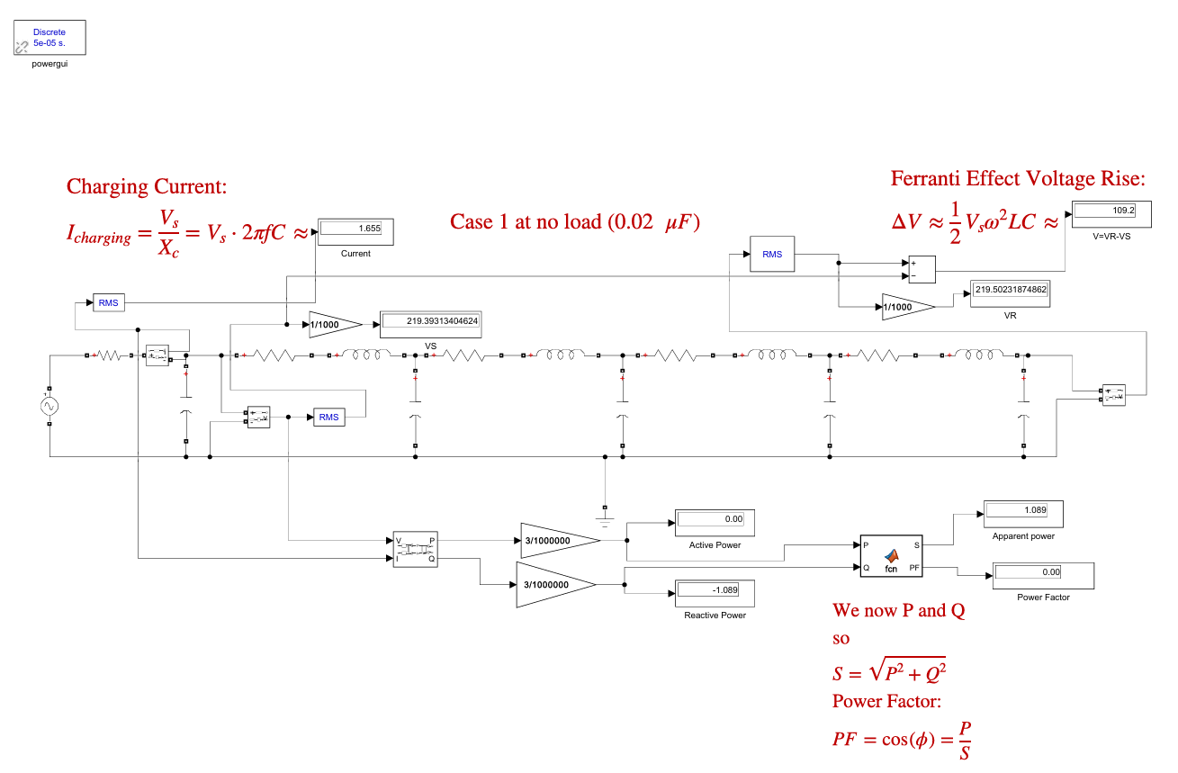
MATLAB simulator
To understand the topic in depth, we will need an electrical analysis in MATLAB. We will assume that the system used is a 220 kV per phase for three-phase generator, i.e., after the generator and the transformer. Then we will plot the transmission line loads as three scenarios, and we will show in each scenario the effect that appeared on it, assuming there is no load. Then we will introduce a load and gradually increase it to observe the decrease and disappearance of the effect.

Slide 5
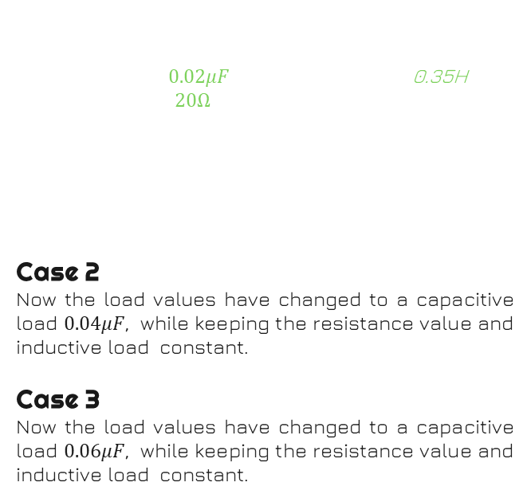
Case 1
We will assume that the transmission line has a capacitive load $0.02μF$, an inductive load 0.35H, and a resistive load $20Ω$ As we can see from the table, there is no active power, even though there is a resistive load in the transmission lines. The reason is simple: comparing the resistive load with the current flowing through it and the reactive power, the difference is so large that it is negligible.
Case 2
Now the load values ​​have changed to a capacitive load $0.04μF$, while keeping the resistance value and inductive load constant.
Case 3
Now the load values ​​have changed to a capacitive load $0.06μF$, while keeping the resistance value and inductive load constant.
No Load Case
219.5 Kv
-1.1 MVAR
1.66 A
0 W
Case 1
Voltage
Receive
Current
Active Power
Reactive Power

Slide 6
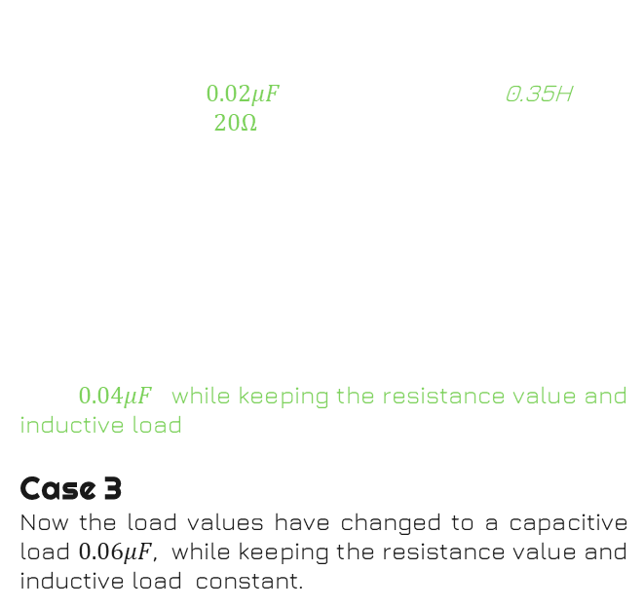
Case 1
We will assume that the transmission line has a capacitive load $0.02μF$, an inductive load 0.35H, and a resistive load $20Ω$ As we can see from the table, there is no active power, even though there is a resistive load in the transmission lines. The reason is simple: comparing the resistive load with the current flowing through it and the reactive power, the difference is so large that it is negligible.
Case 2
Now the load values ​​have changed to a capacitive load $0.04μF$, while keeping the resistance value and inductive load constant.
Case 3
Now the load values ​​have changed to a capacitive load $0.06μF$, while keeping the resistance value and inductive load constant.
No Load Case
-2.18 MVAR
219.5 Kv
219.6 Kv
-1.1 MVAR
3.31 A
1.66 A
0 W
0 W
Case 1
Case 2
Voltage
Receive
Current
Active Power
Reactive Power

Slide 7
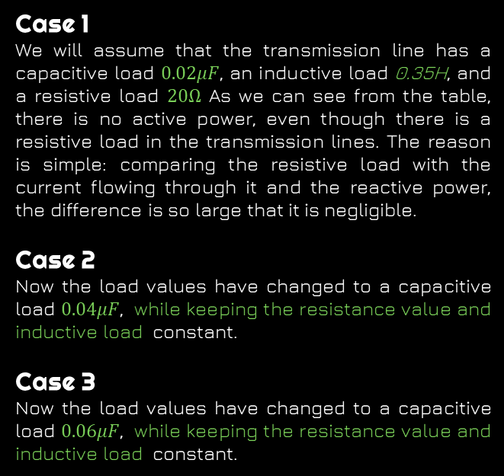
Case 1
We will assume that the transmission line has a capacitive load $0.02μF$, an inductive load 0.35H, and a resistive load $20Ω$ As we can see from the table, there is no active power, even though there is a resistive load in the transmission lines. The reason is simple: comparing the resistive load with the current flowing through it and the reactive power, the difference is so large that it is negligible.
Case 2
Now the load values ​​have changed to a capacitive load $0.04μF$, while keeping the resistance value and inductive load constant.
Case 3
Now the load values ​​have changed to a capacitive load $0.06μF$, while keeping the resistance value and inductive load constant.
No Load Case
-3.27 MVAR
-2.18 MVAR
219.6 Kv
219.7 Kv
219.5 Kv
-1.1 MVAR
4.96 A
3.31 A
1.66 A
0 W
0 W
0 W
Case 1
Case 2
Case 3
Voltage
Receive
Current
Active Power
Reactive Power

Slide 8
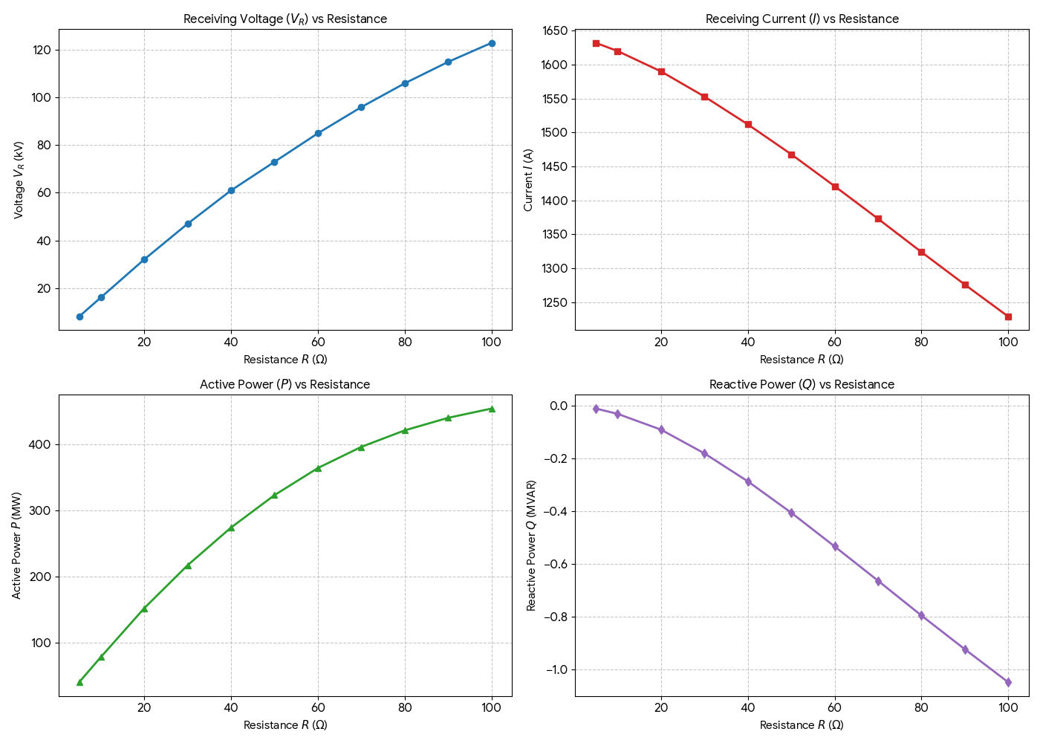
Load Case
Now, let's consider the third case, which acts as the worst-case scenario. We gradually increased the resistance to observe the effect. As expected, the receiving current began to decrease as the load became heavier, and consequently, the receiving voltage dropped below the generating voltage. The resulting figures, such as 1500 A or 120 kV, might initially seem illogical compared to the pre-load state. However, the reason is simple: we are measuring directly within the high-voltage range without using a transformer, and we are measuring specifically at the load rather than the entire system. We will later demonstrate real-world examples of how to counteract this effect.

Slide 9
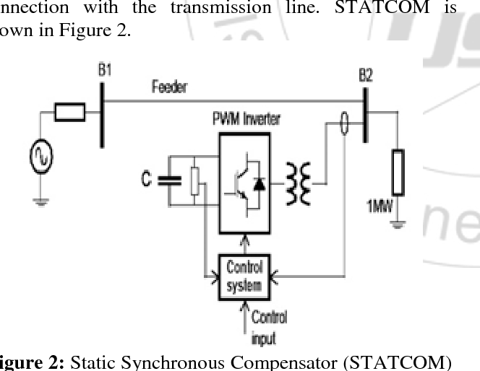
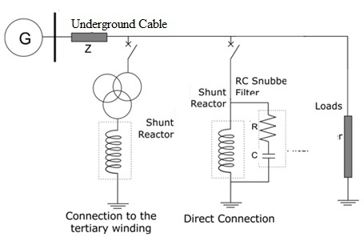
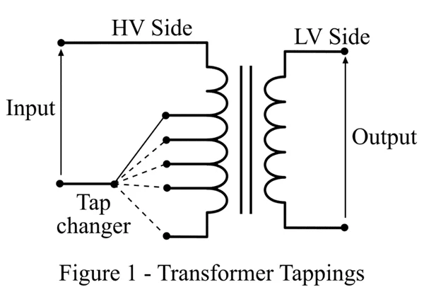
Realistic solutions
Shunt Reactors
Transformer Tap Changer Adjustment
FACTS Devices
Flexible AC Transmission Systems such as Static VAR Compensators (SVC) and STATCOMs dynamically control reactive power in real time. These devices automatically absorb or supply reactive power to maintain voltage stability and suppress the Ferranti Effect under varying load conditions.
Shunt reactors are installed at the receiving end or along long transmission lines to absorb excess reactive power generated by line capacitance
On-load or off-load tap changers are used to adjust the transformer voltage ratio. By lowering the secondary voltage

Slide 10
conclusion
Through experimentation, we learned to understand the Ferranti effect and how it impacts electrical systems. We applied the experiment realistically in a MATLAB simulator. We learned how increasing the load reduces the resulting effect and discovered practical solutions used in electrical systems.

Slide 11
Thanks!
Any quotations

